Slide 1


APJ Abdul Kalam Technological University
Government Engineering College, Palakkad​
​
Department of​ Electronics and Communication Engineering
CLASSIFICATION OF AUTISM AND ADHD USING EEG BASED ON DEEP LEARNING
PROJECT GUIDE:
GROUP MEMBERS:
Assistant Professor
Dr. Jayadevan R
Arun J Dev
Femina N
Nikhil K J
Chithira M

Slide 2
INTRODUCTION
ASD and ADHD are two common neurodevelopmental disorders that affect millions of individuals worldwide.
Deep learning improves medical diagnosis accuracy and efficiency.
Deep learning algorithms can identify patterns in clinical data which can be trained on large datasets and can predict neurodevelopmental disorders.
This approach has the potential to enhance the accuracy and reliability of diagnosis, which is critical for early intervention and improving outcomes for individuals with these conditions.

Slide 3
CURRENT PRACTICES IN DIAGNOSIS
ASD diagnosis involves a comprehensive assessment of an individual's behavioral, social, and developmental functioning.
ADHD diagnosis involves a comprehensive assessment of an individual's behavioral, cognitive, and developmental functioning.
Current diagnostic practices rely on interviews, observation, and rating scales that can be time-consuming and require trained professionals.

Slide 4
PROBLEM STATEMENT
The readings of EEG signals are analyzed by neurologists to detect and categorize the patterns of the disorder.​
The visual examination is time-consuming and laborious and it requires the services of an expert.​
Absence of an implemented automated system to detect the neurological disorders at an early stage of life.
Diagnosis can be complicated by overlapping symptoms between ASD and ADHD, as well as comorbid conditions.

Slide 5
OBJECTIVE
To select an alternative method for the detection of neurological disorder by performing classification using EEG signals based on deep learning to get a relatively high degree of accuracy.
Many lives are impacted by undetected neurological disorders in their early stages .Our project aims to change this through an innovative AI-based classification system.

Slide 6
BACKGROUND STUDY
“Global prevalence of autism: A systematic review update” a review article by Jinan etal. [8] reviewed studies of the prevalence of autism worldwide, considering the impact of geographic, ethnic, and socioeconomic factors on prevalence estimates. Approximately 1/100 children are diagnosed with autism spectrum disorder around the world.
In the article “ADHD and learning disabilities: Research findings and clinical implications” by DuPaul et al. [9] the relationship between the symptoms of ADHD and academic underachievement has been well documented.Children with attention-deficit/hyperactivity disorder (ADHD) are at higher than average risk for academic achievement difficulties and learning disabilities (LDs). Several decades of research indicate that about 27% to 31% of students with ADHD also have LDs, although estimates vary widely depending on the criteria used to define LDs.

Slide 7
BACKGROUND STUDY
"Automated EEG-Based Diagnosis of Attention Deficit Hyperactivity Disorder (ADHD)" by M. Arns et al. [10]: The paper proposes an automated EEG-based diagnostic system for ADHD using a machine learning algorithm. The authors used EEG data from 102 children with ADHD and 102 controls to train and test the algorithm. The results show that the algorithm achieved an accuracy of 89% in classifying ADHD patients from controls.
"EEG-Based Diagnosis of Autism Spectrum Disorder (ASD) Using Machine Learning Techniques" by G. Ramaswamy et al. [11]: The study presents an EEG-based diagnostic system for ASD using machine learning techniques. The authors used EEG data from 28 children with ASD and 28 controls to train and test the algorithm. The results show that the algorithm achieved an accuracy of 92% in diagnosing ASD patients from controls.
"EEG-Based Classification of Learning Disabilities" by T. Adalı et al. [12]: The paper presents an EEG-based classification system for learning disabilities. The authors used EEG data from 58 children with learning disabilities and 58 controls to train and test the algorithm. The results show that the algorithm achieved an accuracy of 84% in classifying learning disability patients from controls.

Slide 8
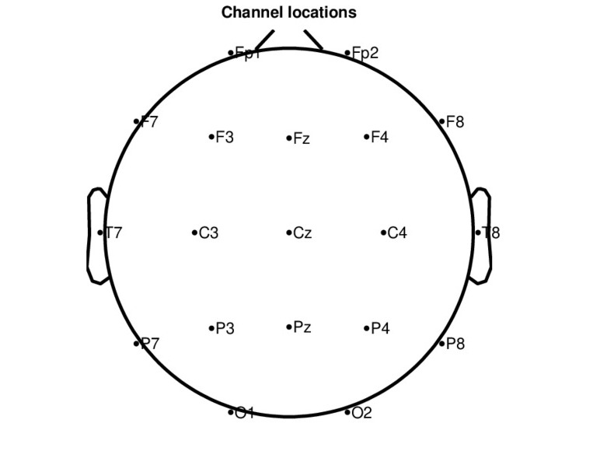
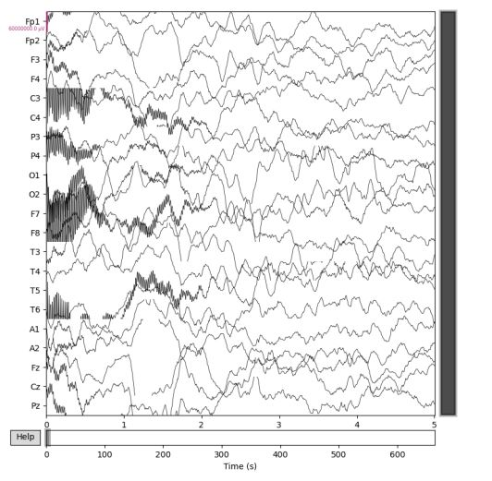
DATASETS
The datasets received from ICCONS includes 16 pure ASD and pure ADHD signals of children between age group of 2-10 years.​
Each signals consists of 21 channels and are sampled at 250Hz.​
Raw EEG data

Slide 9
MNE-PYTHON
MNE-Python is a Python-based software package for analyzing EEG and MEG data.
It includes functions for loading, preprocessing, visualizing, and analyzing neurophysiological data.
Artifact detection and correction functions in MNE-Python can identify and remove eye blinks, muscle activity, and other unwanted noise.
Epoching functions can segment the data into smaller time windows for further analysis.

Slide 10
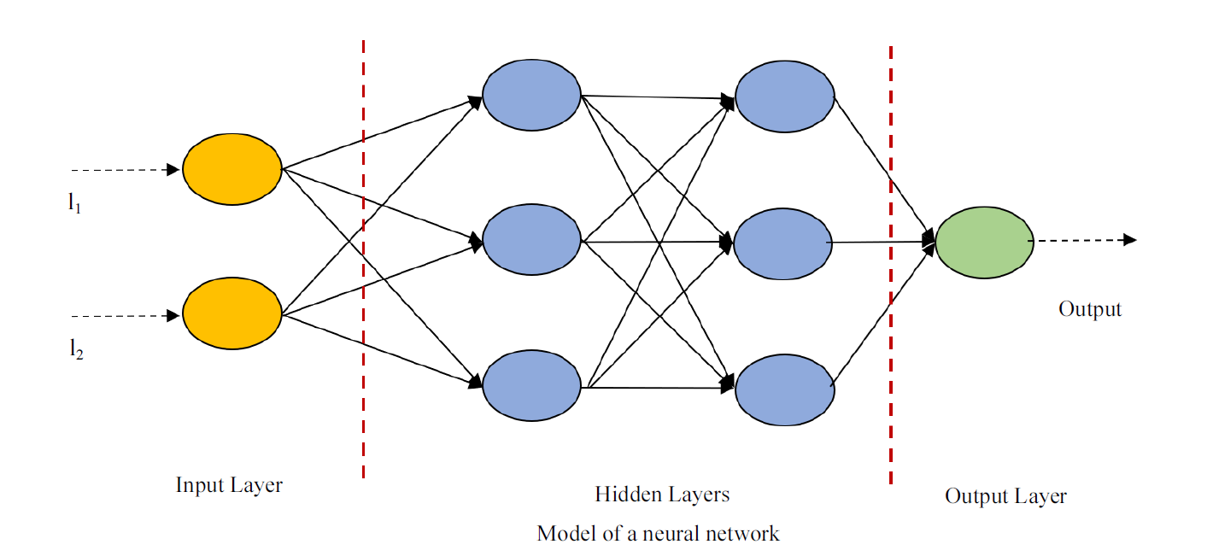
DEEP LEARNING
A machine learning technique that teaches computers to do what comes naturally to humans: learn by example.
Computer model learns to perform classification tasks directly from images, text, or sound.
Most deep learning methods use neural network architectures.
Given enough amount of Training samples, neural networks can classify most of the complex relationships.
10

Slide 11
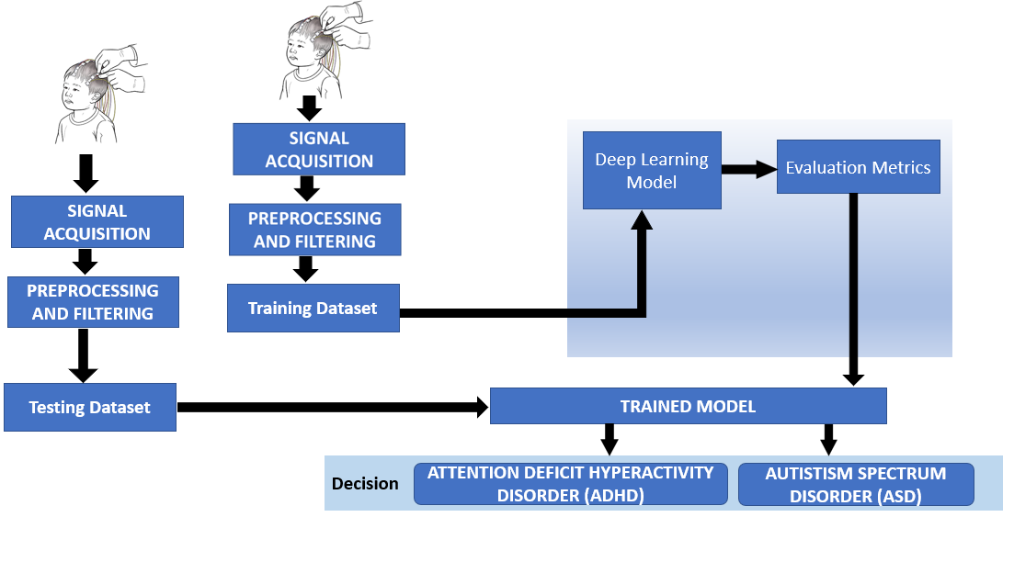
METHODOLOGY

Slide 12
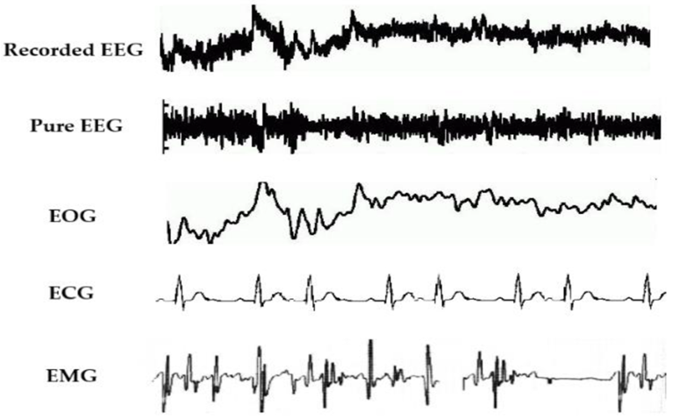
PRE-PROCESSING
Noise and artifacts can reduce EEG signal quality and impact classification.
Makoto's pre-processing pipeline and the MNE Python will be used to address this.
Pre-processing improves data quality, reduces noise, and saves time for more accurate analysis.
Apply a notch filter to remove powerline frequencies from the data.
Apply a bandpass filter with a range of 0.3-60Hz to isolate frequencies of interest for the analysis.
Re-referenced the data by converting the reference to average reference

Slide 13
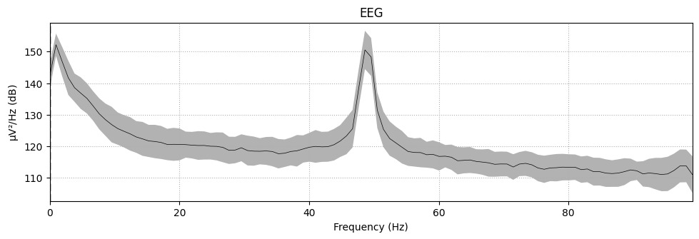
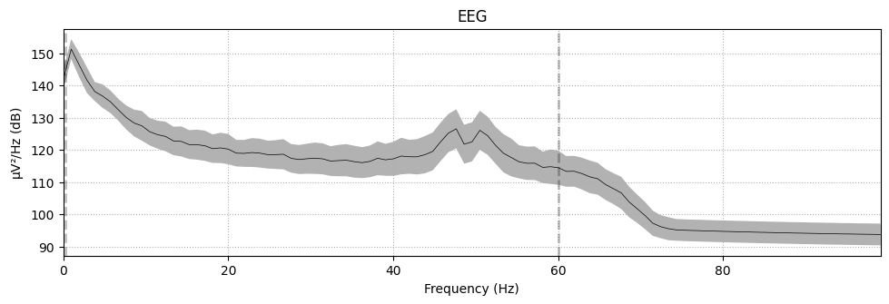
Frequency Response
Raw EEG
Filtered EEG

Slide 14
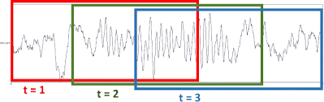
DATA SEGMENTATION
As much as more training samples be available, machine learning models can better estimate the relationships between features.
EEG data is typically collected for several minutes at a time for a single participant.
By splitting the data into shorter segments, better control of the complexity of the input is possible.
Much easier for the deep learning model to learn the relevant patterns in the data.
Will use Hanning Window to split the samples into 7-second segments with 50% overlap which makes the numbers of samples to Train increased [1].
Data Segmentation can implemented using tools such as MNE- Python, EEGLAB.

Slide 15
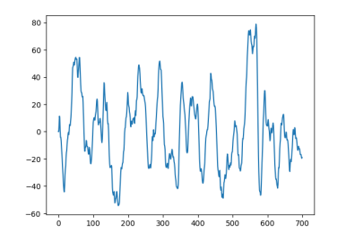
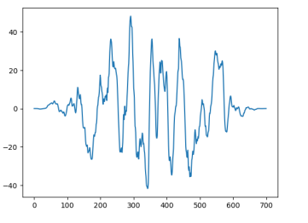
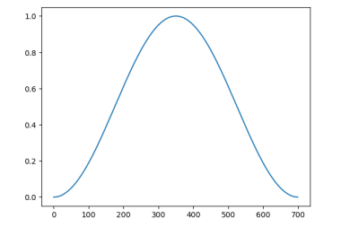
DATA SEGMENTATION​ ​
The Hann window is a type of windowing function that tapers the data at the edges, reducing the artifacts caused by abrupt changes in the signal.
Data after preprocessing and filtering
Multiplying
Segmented data
Hann window with window size 7 sec

Slide 16
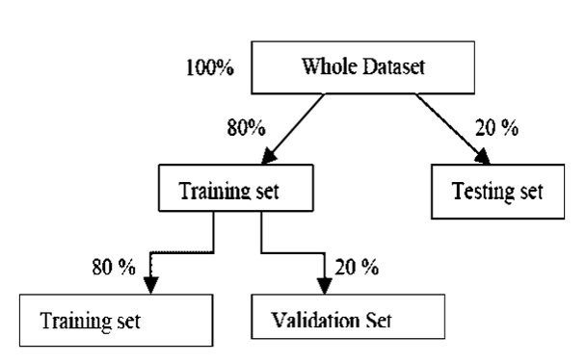
TRAIN-TEST SPLIT
The dataset consisted of EEG recordings from 16 patients with ASD (Autism Spectrum Disorder) and 16 patients with ADHD (Attention-Deficit/Hyperactivity Disorder).
Two patients with ASD and two patients with ADHD were randomly selected from the dataset to be part of the testing dataset.
The remaining 14 patients with ASD and 14 patients with ADHD were used to train and validate the deep learning model.
Training dataset trains the model to classify ASD and ADHD, testing dataset evaluates the model's performance on new data.

Slide 17
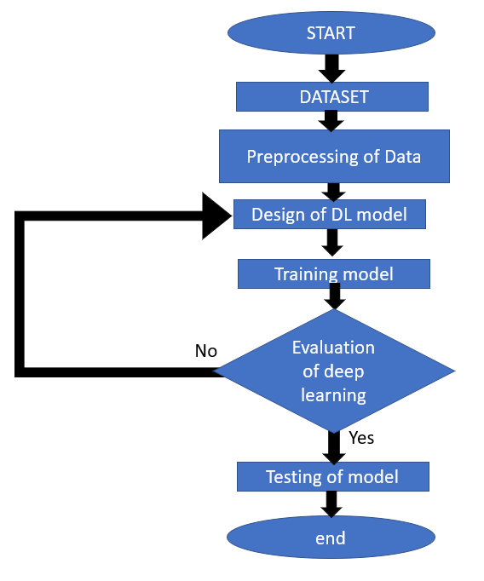
DEEP LEARNING WORKFLOW
17

Slide 18
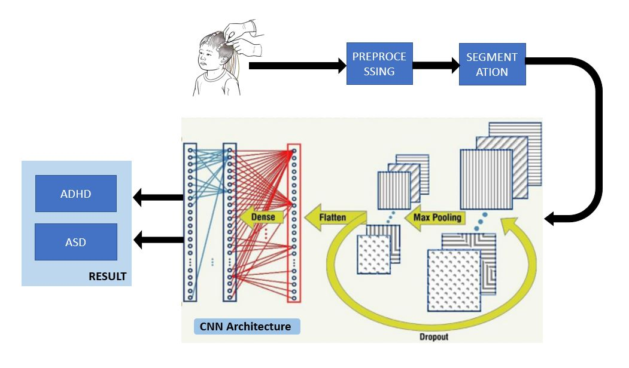
DEEP NEURAL NETWORK
DNN takes an EEG data as input and extracts features of the data using convolution and pooling layers.
Extracted features are fed into flattening and fully-connected layers for classification.

Slide 19
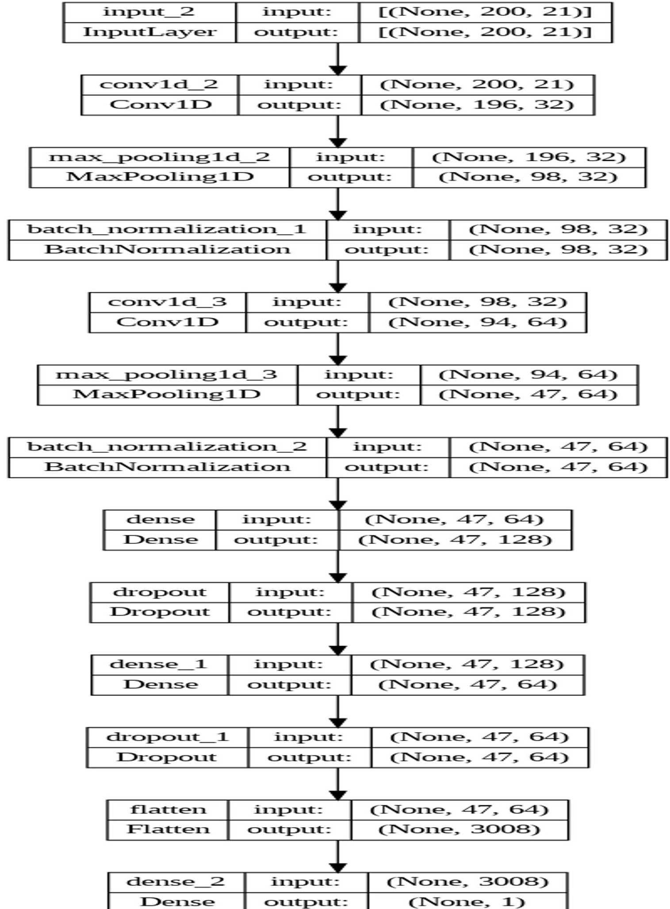
DL MODEL ARCHITECTURE

Slide 20
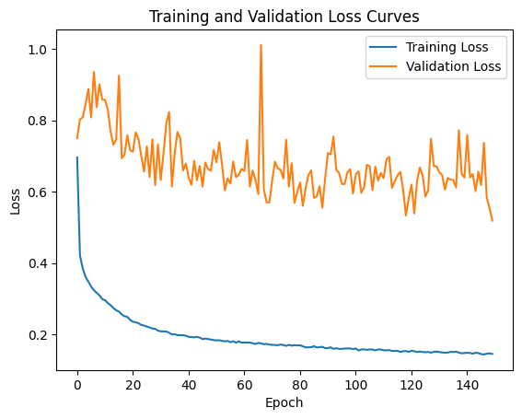
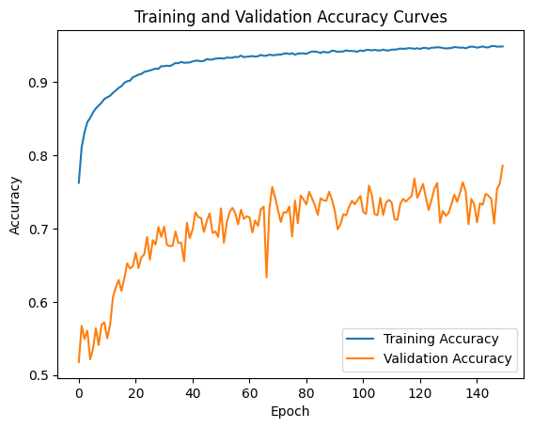
DL RESULT
Train Accuracy : 0.94
Validation accuracy: 0.77
Test accuracy: 0.739

Slide 21
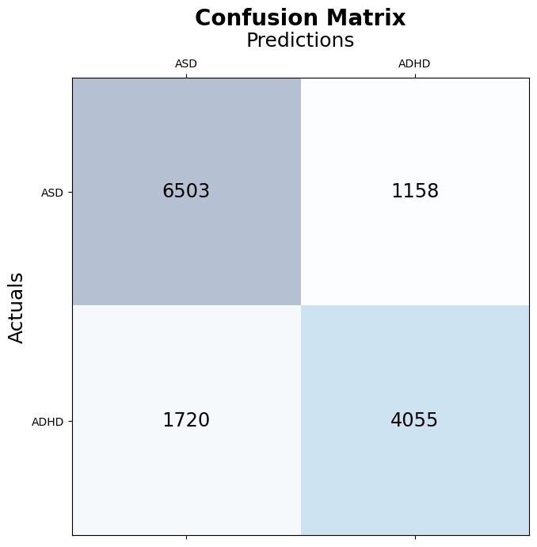
Confusion Matrix Segment wise
True Positive (TP): 4055
True Negative (TN): 6503
False Positive (FP): 1158
False Negative (FN): 1720

Slide 22
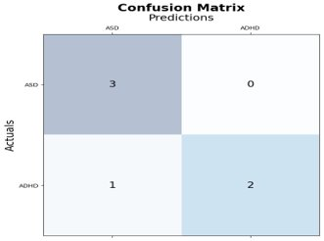
Confusion Matrix Subject Wise
Accuracy: 0.79​​
Precision: 0.78​​
Recall: 0.7​​
F1-score: 0.74

Slide 23
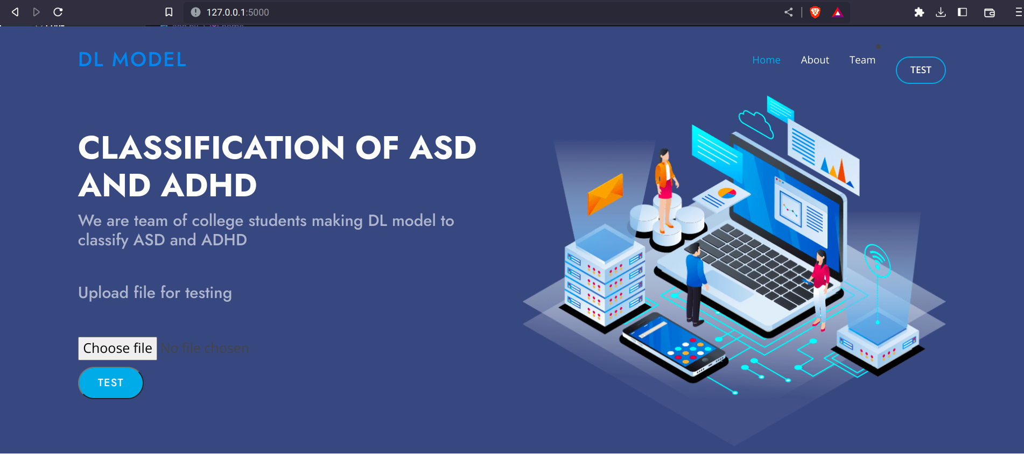
ASD vs. ADHD EEG Classifier

Slide 24
REFERENCE
[1] Moghaddari, M., Lighvan, M. Z., & Danishvar, S. (2020). Diagnose ADHD disorder in children using convolutional neural network based on continuous mental task EEG. Computer Methods and Programs in Biomedicine, 197, Article 105738. https://doi.org/ 10.1016/j.cmpb.2020.105738
[2] Akhtar, M. T., Mitsuhashi, W., & James, C. J. (2012). Employing spatially constrained ICA and wavelet denoising, for automatic removal of artifacts from multichannel EEG data. Signal processing, 92(2), 401-416.
[3] Uyulan, C., Ergüzel, T. T., Unubol, H., Cebi, M., Sayar, G. H., Nezhad Asad, M., & Tarhan, N. (2021). Major depressive disorder classification based on different convolutional neural network models: Deep learning approach. Clinical EEG and Neuroscience, 52(1), 38–51. https://doi.org/10.1177/1550059420916634, 1550059420916634.
[4] Saby, J. N., & Marshall, P. J. (2012). The utility of EEG band Power Analysis in the study of infancy and early childhood. Developmental Neuropsychology, 37(3), 253–273. https://doi.org/10.1080/87565641.2011.614663

Slide 25
REFERENCE
[5] Bi, X., & Wang, H. (2019). Early Alzheimer’s disease diagnosis based on EEG spectral images using deep learning. Neural Networks: The Official Journal of the International Neural Network Society, 114, 119–135. https://doi.org/10.1016/j. neunet.2019.02.005
[6] Chen, H., Song, Y., & Li, X. (2019a). A deep learning framework for identifying children with ADHD using an EEG-based brain network. Neurocomputing, 356, 83–96. https:// doi.org/10.1016/j.neucom.2019.04.058. Scopus.
[7] "Makoto’s preprocessing pipeline." https://sccn.ucsd.edu/wiki/Makoto’s _ preprocessing _ pipeline
[8] Zeidan J, Fombonne E, Scorah J, Ibrahim A, Durkin MS, Saxena S, Yusuf A, Shih A, Elsabbagh M. Global prevalence of autism: A systematic review update. Autism Res. 2022 May;15(5):778-790. doi: 10.1002/aur.2696. Epub 2022 Mar 3. PMID: 35238171; PMCID: PMC9310578.

Slide 26
REFERENCE
[9] DuPaul, George & Volpe, Robert. (2009). ADHD and learning disabilities: Research findings and clinical implications. Current Attention Disorders Reports. 1. 152-155. 10.1007/s12618-009-0021-4.
[10] Arns, M., Conners, C. K., & Kraemer, H. C. (2013). Automated EEG-based diagnosis of attention deficit hyperactivity disorder: A multi-site validation study. Clinical EEG and neuroscience, 44(4), 288-297.
[11] G. Ramaswamy et al., "EEG-Based Diagnosis of Autism Spectrum Disorder (ASD) Using Machine Learning Techniques," Journal of Autism and Developmental Disorders, vol. 47, no. 10, pp. 3345-3355, Oct. 2017
[12] Adalı, T., Anderson, C., Pierce, D., & Barbour, R. (2015). EEG-Based Classification of Learning Disabilities. IEEE Transactions on Neural Systems and Rehabilitation Engineering, 23(6), 1027-1035. doi: 10.1109/TNSRE.2015.2421985

Slide 27
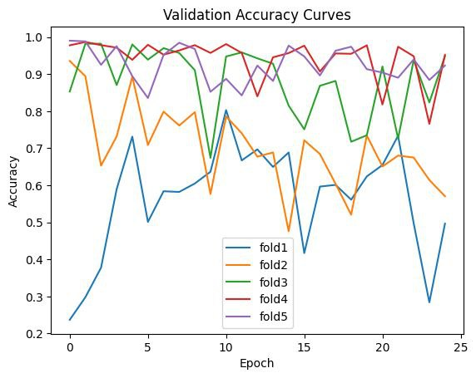
5-FOLD CROSS-VALIDATION FOR DEEP LEARNING
Helps to prevent overfitting in deep learning models.
Data is divided into 5 equally sized folds.
Model is trained on 4 folds and evaluated on the remaining fold.
Process is repeated 5 times with a different fold held out each time.
Results are averaged for a final estimate of the model's performance.

Slide 28
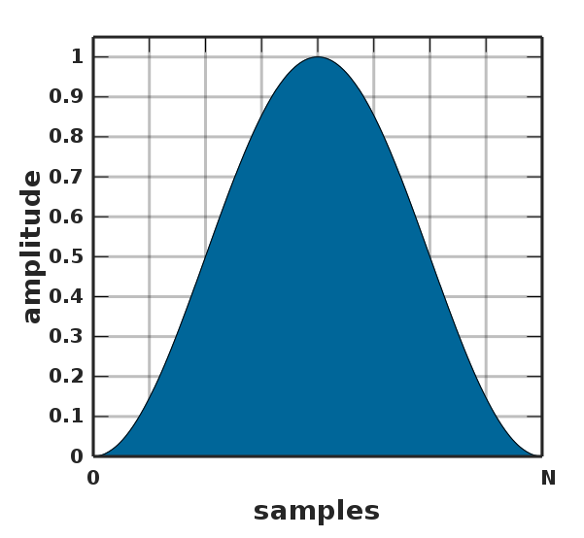
HANNING WINDOW
A Hanning window is a type of window function commonly used in digital signal processing to reduce spectral leakage when analysing a finite segment of a longer signal, and can help improve the accuracy of frequency analysis by reducing spectral leakage and smoothing the signal at segment edges.
The Hanning window is a type of cosine-based window function that is defined by the formula:
w(n) = 0.5 - 0.5cos(2pi*n/N)​

Slide 29
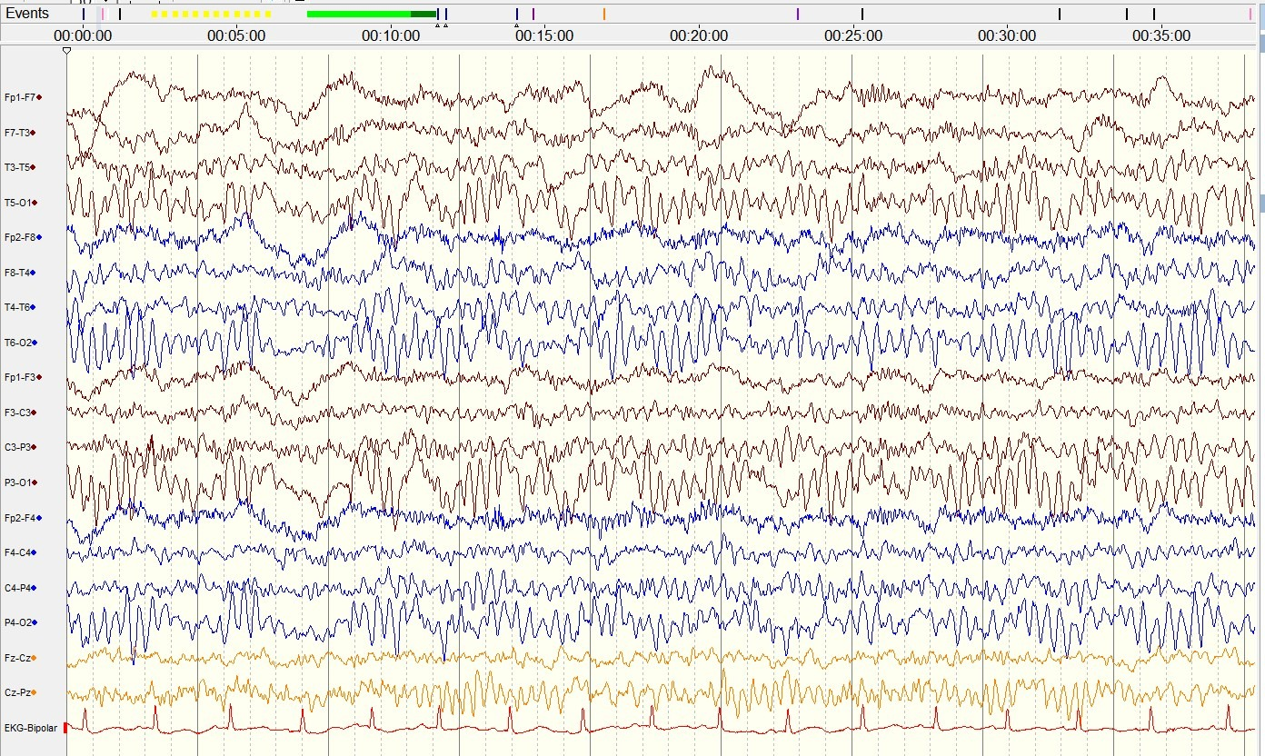
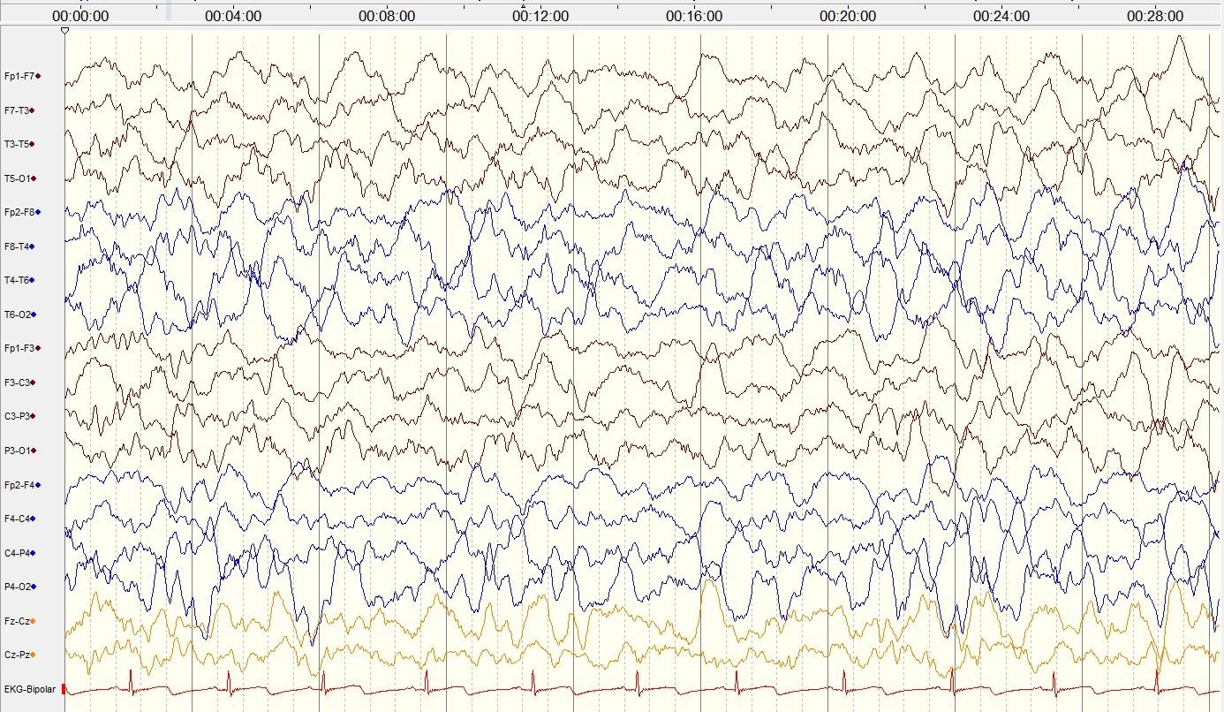
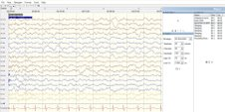
Raw EEG data of an ADHD patient
Raw EEG data of an ASD patient​

